Slide 1
Reward Learning – A Trial-level Approach to Understanding and Linking Behavioral and Neural Responses in both Humans and Rats
Ty Lees, PhD
October 2025
Notes:
Thanks to everyone for coming, and to Peter for organizing this symposium. Today I’m going to talk about a study that looked at reward processing concordance between humans and rodents, and use that as a case study to look at how moving beyond average-level ERPs can be a useful tool.

Slide 2
Reward-Responsiveness & -Learning
Aberrant reward processing may play a role in multiple forms of psychopathology, most notably depression.
Reward Learning
  ‘A process by which organisms acquire information about stimuli, actions, and contexts that predict positive outcomes, and by which behavior is modified when a novel reward occurs, or outcomes are better than expected.’
Reward Responsiveness
  ‘Processes that govern an organism’s hedonic response to impending or possible reward (as reflected in reward anticipation), the receipt of reward (as reflected in initial response to reward) and following repeated receipt of reward (as in reward satiation).
Insel et al., 2010 - Research domain criteria (RDoC): Toward a new classification framework for research on mental disorders.

Slide 3
Reward Processing & Psychopathology
Preclinical models relevant to psychopathology often suffer from limited translational validity.
  Could be due to difficulties in translation of measurements across species.
Reward learning and responsiveness are transdiagnostic RDoC constructs of interest embedded in the Positive Valence Systems domain.
  Offer targets for measurement that may be valid across-species.
  Electroencephalography (EEG) can be used to index these constructs, offers detailed insight into neurodynamics, and can be applied to both species.
Concordance between species?
Clayson et al., 2020; Keren et al., 2018; Moran et al., 2017; Pizzagalli et al., 2009; Thompson et al., 2023
Notes:
Very briefly – the rationale that motivated this study was based on the challenges in translating preclinical models of psychopathology into humans, and the possibility that reward processing could be leveraged to rectify this given it’s transdiagnostic nature and ability to be measured using EEG across species.
The high-level question underlying this work being what aspects of reward processing are concordant across species and what parts are not?

Slide 4
Aims & Hypotheses
In the present work, we aimed to:
​​Identify behavioral and neurophysiological indices of reward processing across species.
  ​​Replicate our previous study. _{(Der-Avakian et al., 2025)}
  ​Extend previous trial-level analysis to further explore reward-learning behavior.
​Determine if methylphenidate (MPH), administered in a random cross-over design, modulates reward processing indices across species.
  ​Humans – 0 mg, 15 mg, 30 mg MPH
  ​Rodents – 0 mg/kg, 0.5 mg/kg, 1 mg/kg, or 2 mg/kg MPH
​Specific to this talk, describe average- and trial-level analysis approaches and their value.
Notes:
So, in this talk today, I’m going to present some data and results in the vein of the first two aims of the study:
Firstly, identifying these signals and replicating and extending a recent paper we published.
And secondly, examining the effect of Methylphenidate – a dopamine and possibly reward enhancing drug – across species.
I’m also hoping to describe what we’ve gotten out of an average-level analysis and how we’ve been able to augment that with trial-level analyses.

Slide 5



Participants
Humans
  Twenty-five right-handed adults (14 female)
    M_{age} = 27.40, SD_{age} = 5.72
    Screened to be psychologically healthy using the SCID.
Rodents
  Twenty-three Long-Evans rats
    13 Males (226 – 250 g) and 10 Females (176 – 200 g)
    Maintained on a 12h light/dark cycle with ad libitum access to water
  Mildly food-restricted during training and testing.
Notes:
Briefly, we had 25 adult participants and 23 rodents complete the study using a randomized cross-over design. Humans completed 3-sessions preceded by different doses of Methylphenidate and rodents completed 4.

Slide 6
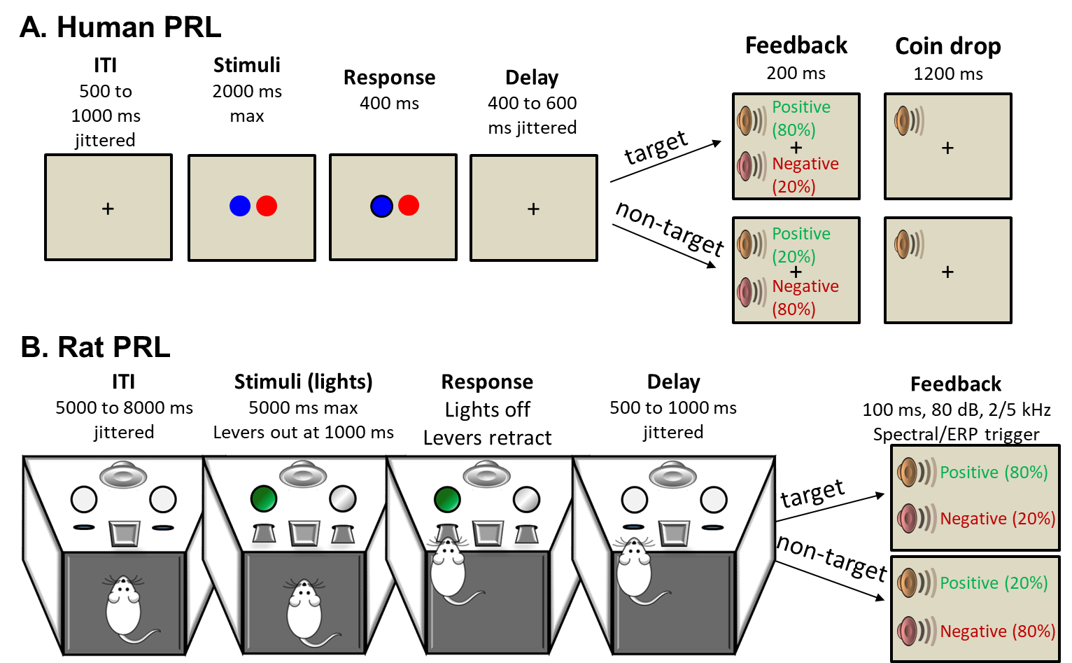
Probabilistic Reversal Learning Task
Both species completed 300 trials across the full task.
Trials were rewarded on an 80%/20% schedule (i.e., targets were reward at 80% probability, non-targets rewarded at 20% probability).
Behavior was modeled using a Q-learning model (3 free parameters: alpha, beta, forget).
Notes:
During each session, both humans and rodents completed a Probabilistic Reversal Learning Task of 300 trials with a 80%/20% reward schedule. The Human task was a typical two-option visual choice task, where one of the two options was pre-selected to be the target choice which was rewarded at 80% and the other was the non-target which was rewarded at 20%. Subjects simply had to choose one of the two and would be rewarded and given feedback at these probabilities. Notably, the which stimuli was the target switched after a subject made 8 consecutive target responses. Rodents completed a task designed to be as analogous as possible using response levers and lights.
We captured neural data during the task from both humans and rodents - Humans using scalp EEG, and rodents using electrodes implanted in the brain, notably in the ACC.
The last important thing to note is that the behavior of both humans and rodents were computationally modelled using a Q-learning model with three free parameters.

Slide 7
Task-level Analysis
Notes:
Onto the results, and starting with some typical task-level or averaged analysis.

Slide 8
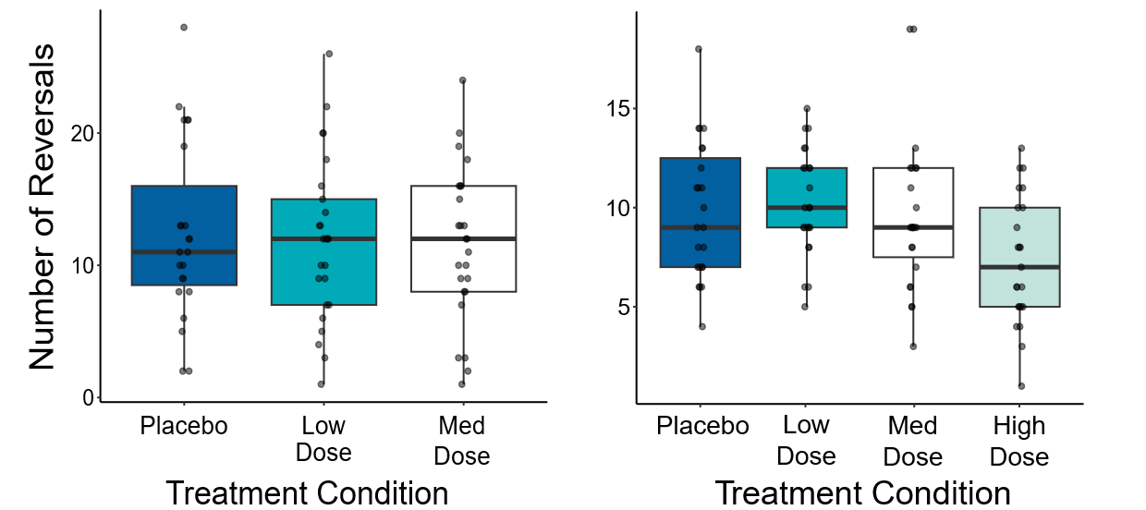
Task Performance and Behavior
Humans
Rodents
Notes:
Starting with task performance, in humans, we generally see that the number of reversals made in the task was largely the same across the different MPH conditions. And, surprisingly, we see roughly comparable performance in rodents – there are some differences, slightly lower total number of reversals, and the dip in performance in the highest dose condition. But it’s pretty on par.

Slide 9
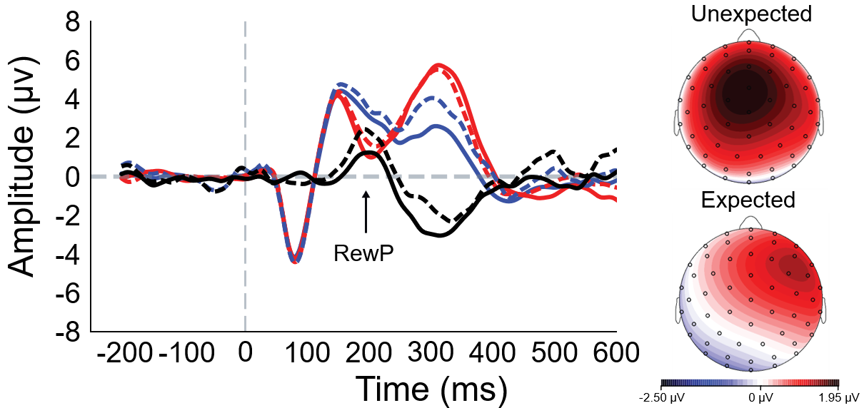
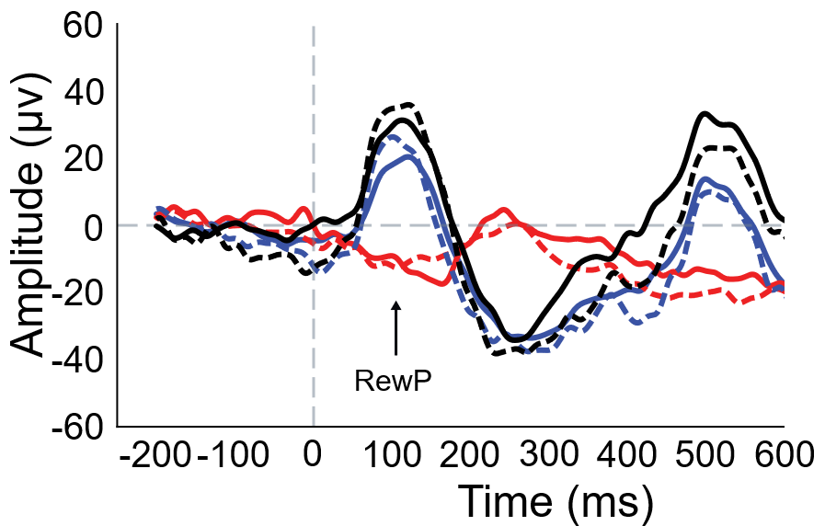
Neural Response to Reward
Rodents
Humans
Notes:
Moving to the neural data, if we look at the averaged response to the reward feedback stimuli, we see a similar alignment between species. Humans demonstrate a RewP, calculated as the reward – nonreward difference, peaking around 200 ms, and Rodents show a similar kind of response a little earlier, peaking around 100 ms.
I want to note that these are Grand-average ERPs from only the Placebo/Vehicle condition (i.e., without MPH), but the traces from the other conditions look very similar.

Slide 10
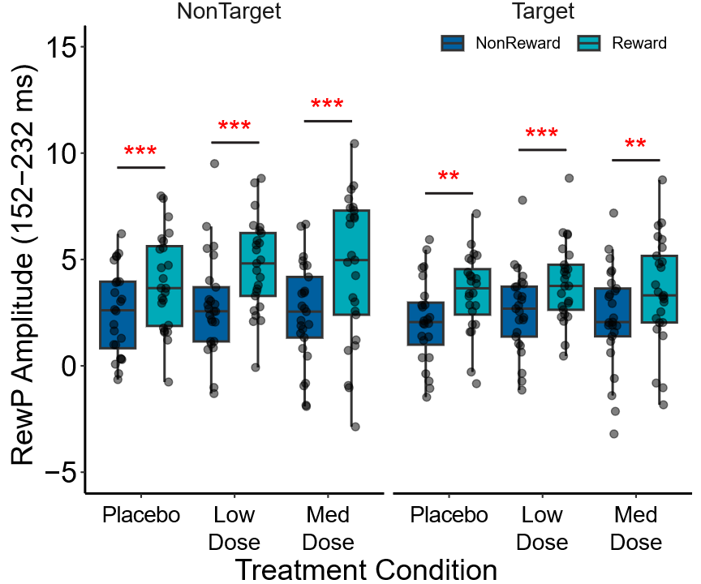
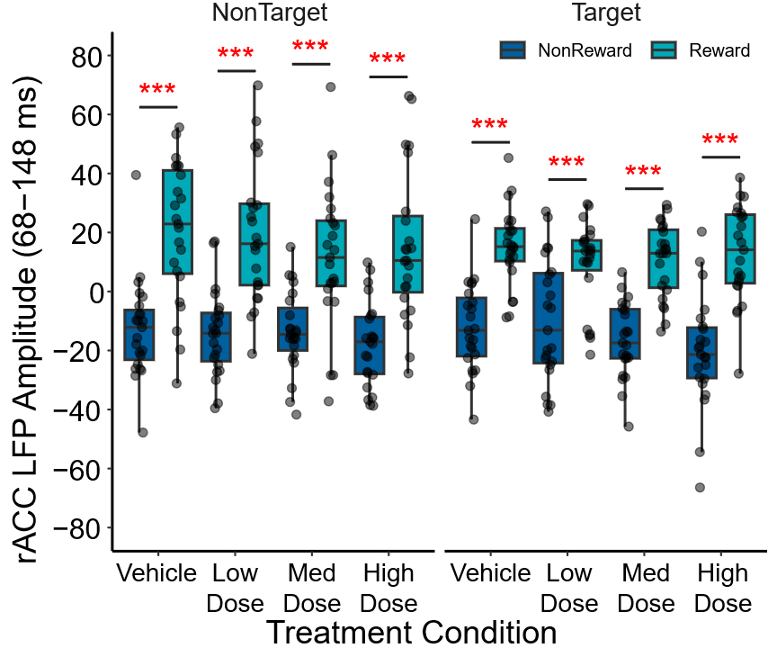
Neural Response to Reward
Humans
Rodents
Notes:
Indeed, if you plot the amplitude of the measured ERPs, you can see the effects across doses. Signals differ largely by reward status and somewhat by trial-type, i.e., target vs. non-target selection. And this is true for both humans and rodents.

Slide 11
Humans and rats both exhibit comparable performance and an early ERP that may index initial response to reward
Notes:
So, from this averaged data, we suggest that there seems to be a conservation of task performance and this early reward response across species. But as an analytical approach it dissolves a lot of the nuance of the task.

Slide 12
Trial-level Analysis
Notes:
So, what if we look at concordance at a trial-level?

Slide 13
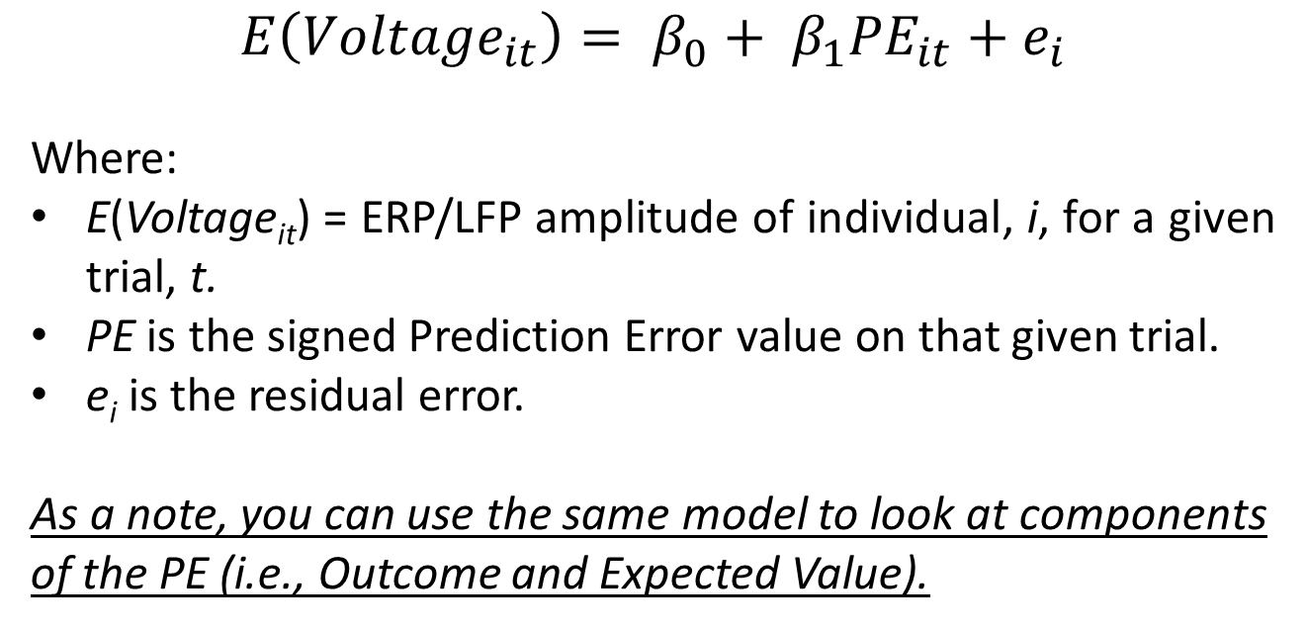
Relationship between RewP and Prediction Error
Averaged Trial-level Data
$$E\left({Voltage}_{it}\right)= β_{0}+ β_{1}{PE}_{it}+e_{i}$$
Where:
E(Voltage_{it}) = ERP/LFP amplitude of individual, i, for a given trial, t.
PE is the signed Prediction Error value on that given trial.
e_{i} is the residual error.
As a note, you can use the same model to look at components of the PE (i.e., Outcome and Expected Value).
Notes:
A simple starting place is the relationship between the RewP and Prediction error. Derived from our computational models, the prediction error is “The difference between an expected value and the actual outcome”
Positive prediction error: Occurs when the outcome is better than expected.
Negative prediction error: Occurs when the outcome is worse than expected.
Using a relatively simple linear mixed-effects model that predicts average ERP amplitude on a given trial by the trial-specific PE, we can look at this relationship. As a note, you can also look at the individual components of the PE. If you’re interested check in with me about it later.

Slide 14
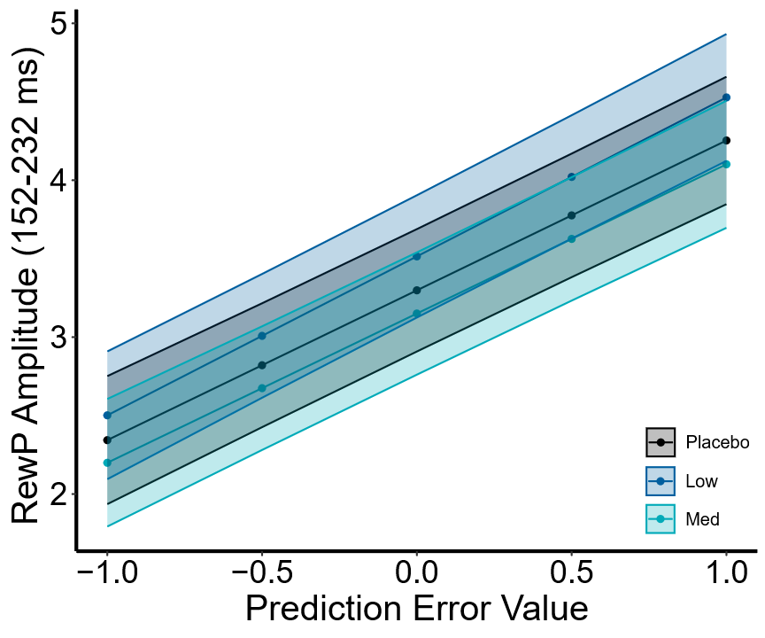
Relationship between RewP and Prediction Error
Human Trial-level Data
Fixed | b (SE) | t | p
Intercept | 3.32 (0.39) | 8.61 | < .001
PE | 0.97 (0.07) | 14.73 | < .001
Treatment 1 (15 mg) | -0.02 (0.06) | -0.41 | .681
Treatment 2 (30 mg) | 0.19 (0.05) | 3.54 | < .001
PE × Treatment 1 | -0.02 (0.09) | -0.19 | .845
PE × Treatment 2 | 0.04 (0.09) | 0.43 | .667
Random | SD | 95% CI
Intercept | 1.92 | 1.45 | 2.56
Residual | 5.73 | 5.68 | 5.78
Notes:
Applying these models, in humans, we see that a more positive prediction error (i.e., a better than expected outcome) is associated with a greater RewP amplitude, something we saw in the ERP plots themselves. Plus, an interesting MPH enhancement of ERP amplitude.

Slide 15
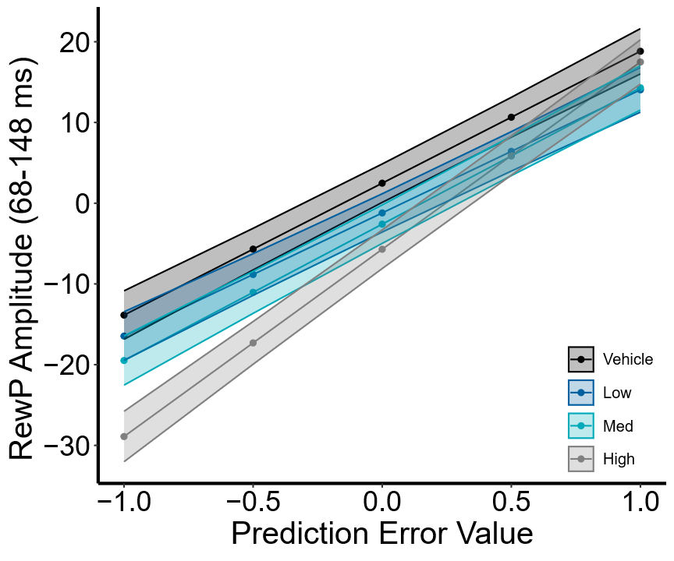
Relationship between RewP and Prediction Error
Rodent Trial-level Data
Fixed | b (SE) | t | p
Intercept | -1.76 (2.22) | -0.79 | .437
PE | 17.92 (0.84) | 21.34 | < .001
Treatment 1 (0.5mg/kg) | 0.55 (0.85) | 0.65 | .515
Treatment 2 (1mg/kg) | -0.84 (0.86) | -0.98 | .329
Treatment 3 (2mg/kg) | -3.95 (0.87) | -4.53 | < .001
PE × Treatment 1 | -2.67 (1.43) | -1.86 | .063
PE × Treatment 2 | -1.03(1.45) | -0.71 | .477
PE × Treatment 3 | 5.28 (1.47) | 3.59 | < .001
Random | SD | 95% CI
Intercept | 10.38 | 7.63 | 14.14
Residual | 77.49 | 76.82 | 78.15
Notes:
And we can see the same positive relationship between RewP and PE emerge in rodents. It is worth noting that we also see an effect of MPH here, but rather than enhancing the ERP amplitude it diminishes it in the highest dose condition, but also strengthens its relationship with the PE.

Slide 16
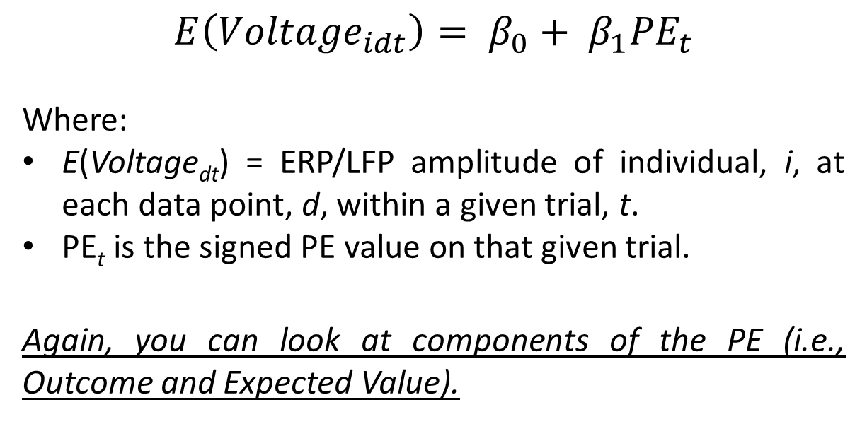
Relationship between RewP and Prediction Error
Datapoints Within a Trial
$$E\left({Voltage}_{idt}\right)= β_{0}+ β_{1}{PE}_{t}$$
Where:
E(Voltage_{dt}) = ERP/LFP amplitude of individual, i, at each data point, d, within a given trial, t.
PE_{t} is the signed PE value on that given trial.
Again, you can look at components of the PE (i.e., Outcome and Expected Value).
Notes:
What if we dig a little deeper, and rather than just an averaged ERP value per trial, we look at the same relationship from each datapoint. Fitting a similar generalized linear model using the ERP voltage at each datapoint in a trial predicted by the trial-level PE and plotting the beta coefficients we get something that looks like this:

Slide 17
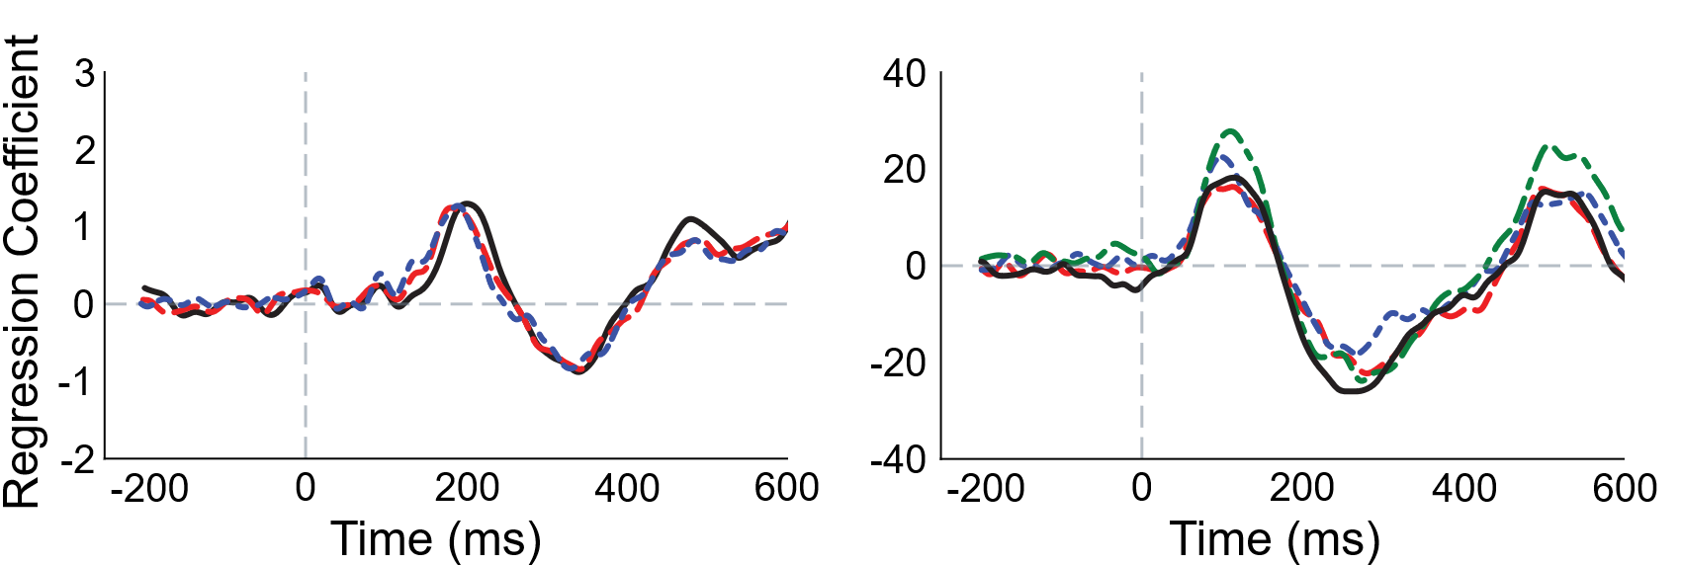
Relationship between RewP and Prediction Error
Datapoints Within a Trial
Humans
Rodents
Notes:
In humans, we see a peak in the regression coefficient that approximately aligns with the RewP difference wave around 200 ms, and we see something similar in the rodents. Importantly, you can see that this is true across all sessions that we recorded and all doses of methylphenidate..

Slide 18
The relationship between initial neural response to reward (i.e., the RewP) and prediction error is conserved across species
Notes:
So, putting these result sets together, it seems that the relationship between the initial neural response to reward and prediction error is conserved across species. A nice set of results that supplement the task-level analysis.
However, while we’ve dug into the task a little more using trial-data, it still doesn’t really break down the nuance of the task, specifically the learning piece. So, what if we try that and follow in the footsteps of Markus Ullsperger and some other SPR members.

Slide 19

Choice Behavior and Neural Response
Previous trial informing current choice
$logit\left(Target\right)= β_{0}+ β_{1}{RewP}_{pt}+β_{2}{Response}_{pt}+$ $β_{3}{Reward}_{pt}+$ $β_{4}{RewP}_{pt}×{Response}_{pt}+$ $β_{5}{RewP}_{pt}×{Reward}_{pt}+$ $β_{6}{Response}_{pt}×{Reward}_{pt}+$ $β_{7}{RewP}_{pt}×{Response}_{pt}×{Reward}_{pt}+β_{8}{PE}_{pt}+β_{9}ln⁡(Trial Number)+$ ${\text{u}}_{i}$
Where:
RewP is the ERP/LFP amplitude on the previous trial, pt.
Response is the previous choice made on the previous trial.
Reward is the outcome of the previous trial.
Trial Number is the log-transformed number of the current trial.
u_{i} is the random intercept for subject, i.
Notes:
We do this by using a logistic choice model with a pretty ugly to look at equation. But a high level we’re looking at predicting the probability of making a target choice on a given trial, based on information from the previous trial including the prior selection (target or non-target), the prior reward outcome (reward or not reward), the prior neural response (i.e. ERP amplitude), their various interactions, and some covariates.
- It’s really an attempt to acutely tie the expected behavior of the task (i.e., updating choice selection based on prior outcomes) with the neural information we capture.

Slide 20
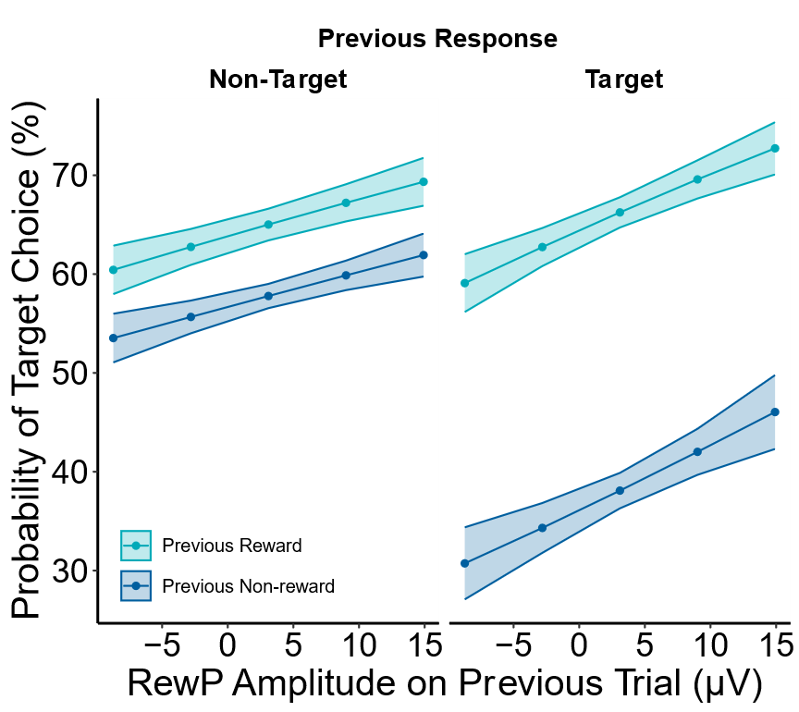
Human Choice Behavior and Neural Response
Fixed | Estimate | SE | z | OR
Intercept | 0.02 | 0.16 | 0.11 | 1.02
Previous RewP | 0.01 | 0.01 | 2.12* | 1.01
Previous Response1 | -0.84 | 0.05 | -16.72*** | 0.43
Previous Reward1 | 0.30 | 0.06 | 4.76*** | 1.35
Previous PE | 0.48 | 0.08 | 6.07*** | 1.62
Log(Trial Number) | 0.05 | 0.03 | 1.54 | 1.05
Previous RewP × Previous Response1 | 0.01 | 0.01 | 1.93† | 1.01
Previous RewP × Previous Reward1 | 0.00 | 0.01 | 0.30 | 1.00
Previous Response1 × Previous Reward1 | 0.87 | 0.05 | 18.55*** | 2.38
Previous RewP × Previous Response1 × Previous Reward1 | -0.00 | 0.01 | -0.55 | 1.00
Random | Estimate | SD
Intercept | 0.02 | 0.15
Notes:
Sticking to just the placebo data to make things easier, we see that our human participants internalized the contingencies of the task. A rewarded response in the last trial was far more likely to lead to a target selection on the current trial regardless of the previous selection; while non-rewarded outcomes were more ambiguous, non-rewarded targets diminished this likelihood, and non-rewarded non-targets were more middle of the road.

Slide 21
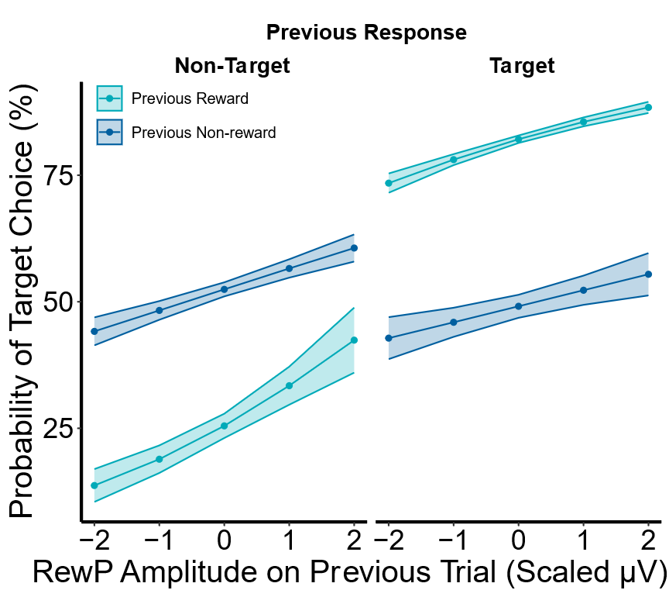
Rodent Choice Behavior and Neural Response
Fixed | Estimate | SE | z | OR
Intercept | -0.22 | 0.15 | -1.48 | 0.80
Previous RewP | -0.01 | 0.04 | -0.14 | 0.99
Previous Response1 | -0.62 | 0.05 | -15.19*** | 0.54
Previous Reward1 | -0.09 | 0.05 | -1.60 | 0.92
Previous PE | -0.14 | 0.08 | -1.85† | 0.87
Log(Trial Number) | 0.07 | 0.03 | 2.41* | 1.08
Previous RewP × Previous Response1 | -0.07 | 0.04 | -1.83† | 0.93
Previous RewP × Previous Reward1 | 0.04 | 0.04 | 1.01 | 1.04
Previous Response1 × Previous Reward1 | 0.67 | 0.04 | 17.87*** | 1.95
Previous RewP × Previous Response1 × Previous Reward1 | 0.01 | 0.04 | 0.35 | 1.01
Random | Estimate | SD
Intercept | 0.00 | 0.02
Notes:
Interestingly, rodents don’t behave in quite the same way, such that they are largely driven by reward. If you reward a target, they are more likely to select a target on the next trial. But if you reward a non-target on the previous trial, they are more likely to select the non-target on the current trial.

Slide 22
Choice behavior is differently driven between species – compared to humans, rodents more highly value reward and previous neural responses have little effect
Notes:
So, from these models, it seems that, rather than being a point of convergence, choice behavior is a place of divergence between humans and rodents. And if we cycle back to the original translational aim of the project, one that we might wish to consider when building preclinical experiments or translational designs (i.e., maybe constraining our work to only reward response and not something like eward learning).

Slide 23
Conclusion
Initial response to reward (indexed by the RewP) and its association with behavior appear to be conserved across species.
  Trial-level ERP approaches provide new targets for analysis that can take advantage of the design and features of commonly used tasks.
  Can enable more nuanced views of the relationships between neural and behavioral data.
  Can be leveraged to provide converging lines of evidence.
Challenges & Future Considerations
  Alignment of data types – especially when rejecting/removing data.
  Trial-level Temporal dynamics – analysis within and across trials.
    Functional Linear Mixed Modeling framework (Loewinger et al., 2024. eLife)
    https://doi.org/10.7554/eLife.95802.3
Notes:
To wrap-up, specific to the aim of this study, It seems that the initial response to reward and it’s association with behavior is conserved across species, but there are species-level differences too. Particularly in choice behavior.
To the aim of this talk, trial-level ERP approaches provide new targets for analysis that can take advantage of the features of common tasks and enable more nuanced views of neural and behavioral data.
That said, there are some things to think about too. I think the most poignant for me was aligning your data at the trial-level, making sure that trial 1 is trial 1 for all data types. As a final note, I also wanted to highlight an interesting recent paper and approach as a future direction. Using photometry it proposes an analytical framework that combines analysis within and across trials and might enable us to fully leverage the temporal precision of EEG.

Slide 24




Acknowledgements
Funding for this project (UH2 MH109334 & UH3 MH109334) was awarded to Diego A. Pizzagalli,
Collaborators
Diego A. Pizzagalli, PhD
Samuel A. Barnes, PhD
Andre Der-Avakian, PhD
Samantha R. Linton, PhD
Ann Iturra-Mena, PhD
Brian D. Kangas, PhD
Genevieve P. Nowicki, MS
Rachel Lobien, MSW
Gordana Vitaliano, MD, PhD
Jack Bergman, PhD
William A. Carlezon Jr, PhD
All other UH2/UH3 Collaborators!
Notes:
Finally, I need to acknowledge the NIMH for the funding of the project that was awarded to Diego Pizzagalli, as well as our collaborators on this work, in particular Sam Barnes and Andre Der-Avakian. And those who worked on the UH project more broadly.

Slide 25
Notes:
Thanks!

